Slide 1


Central London coffee shop problem
Where to open a coffee shop in Central London?

Slide 2


Brief
Identify the best place in Central London to open a coffee shop using data from Foursquare.

Slide 3
Factors to consider
Number of coffee shops already in the area
Population of the area
Average rent in the area

Slide 4
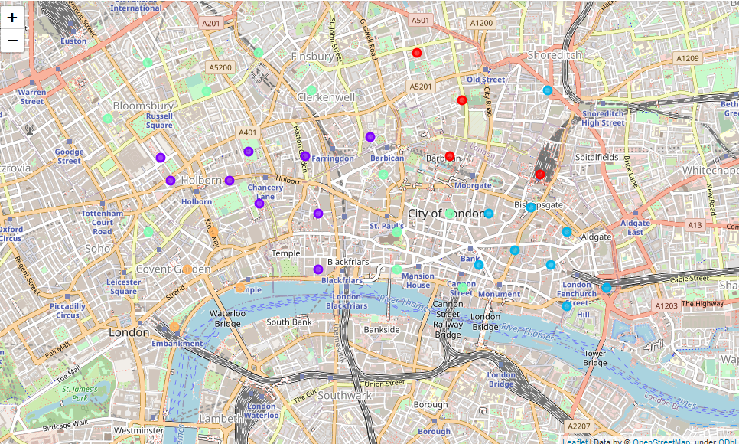
Clustering data

Slide 5
Results
Cluster 3 shown in turquoise on the previous map had the highest number of potential customers per coffee shop and a low rent per potential customer.

